Slide 1
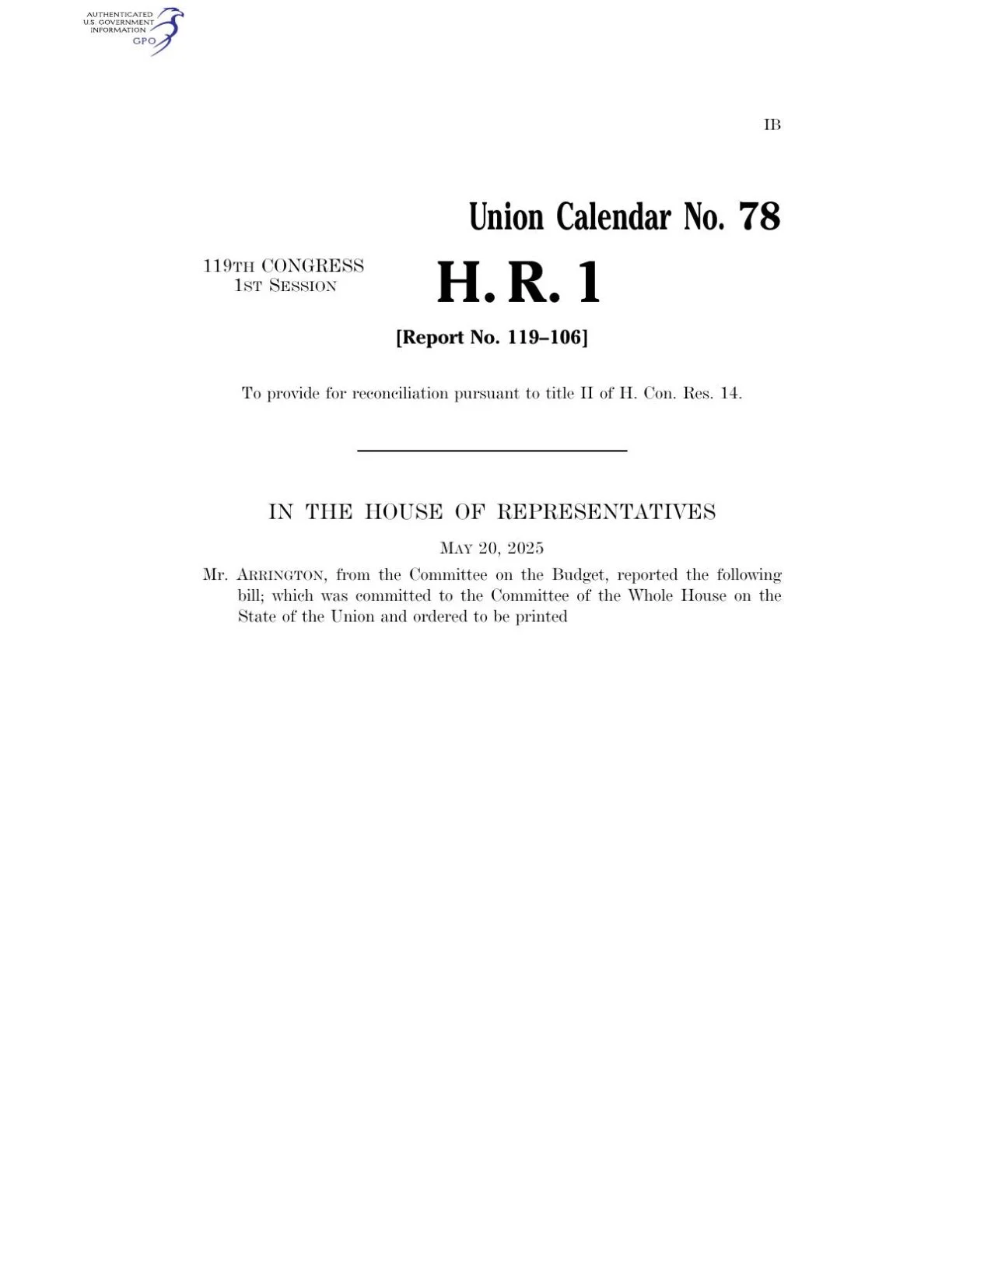
The Current State of Healthcare and Impact of the One Big
Beautiful Bill Act (OBBBA)​
Grand Rapids African American Health Institute
Bill Manns

Slide 2
Disclaimer
What I’m sharing today reflects my own perspective and experiences and shouldn’t be taken as an official position of the organizations I’m privileged to be part of.

Slide 3


Words I Live By
“Be a Man for Others”
Say what you know
Say what you don’t know
Question what you believe
Label accordingly…and examine fearlessly

Slide 4

The Budget and Our Future but first…

Slide 5
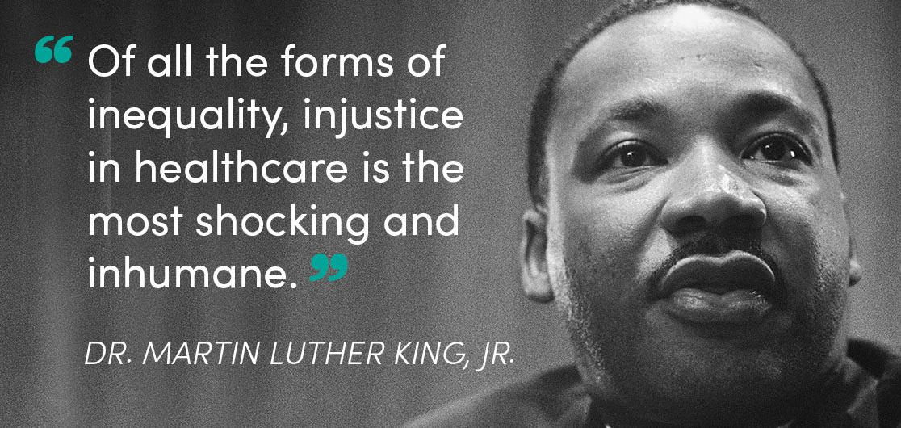

Slide 6

Today…
Black women are 3 -4 times more likely to die from pregnancy related causes than White women
Black men are 2 -3 times more likely to die from preventable heart disease and stroke than their white counterparts

Slide 7
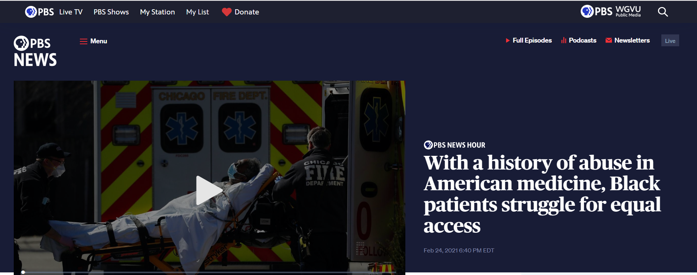
Access Challenges…

Slide 8
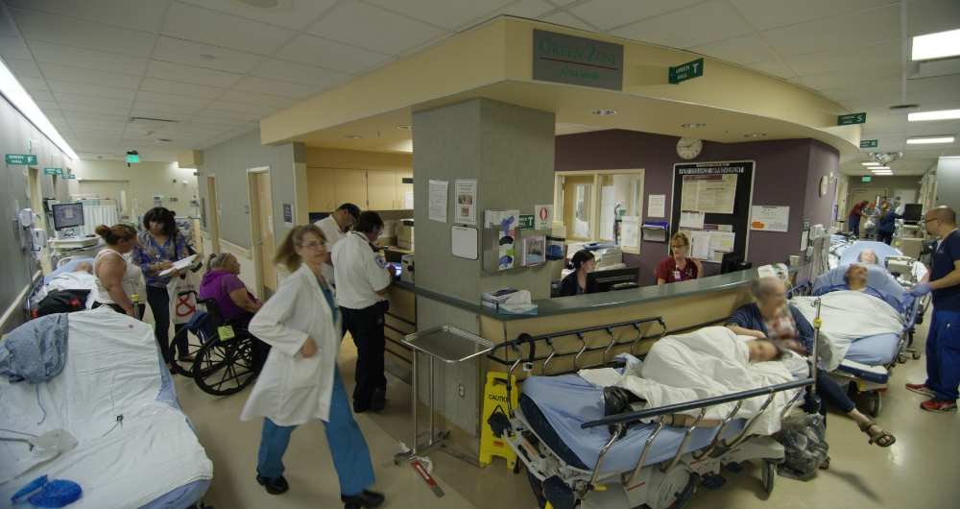
Most of America’s Emergency Departments

Slide 9
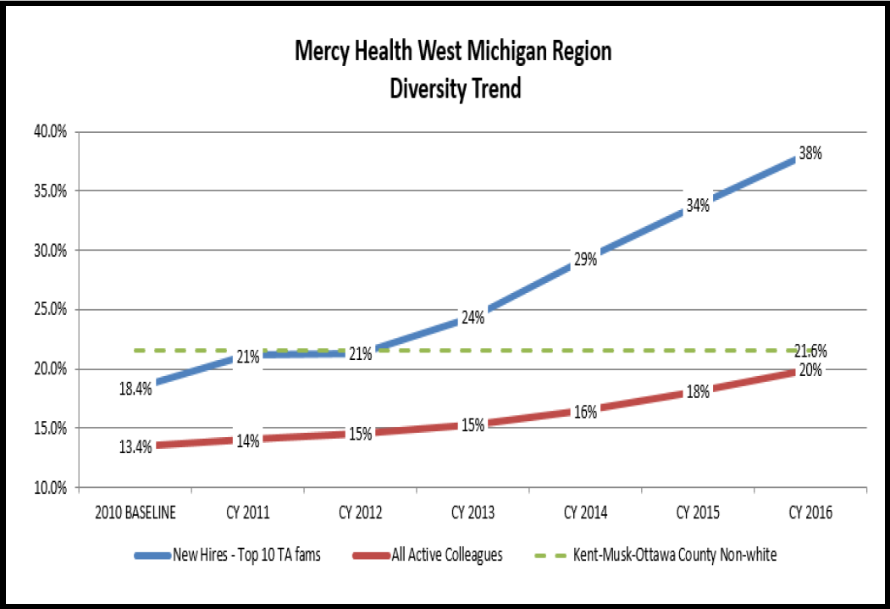
“If you want to improve someone’s health status…give them a job!”
Richard Lichtenstein, MHP, PhD circa 1990

Slide 10
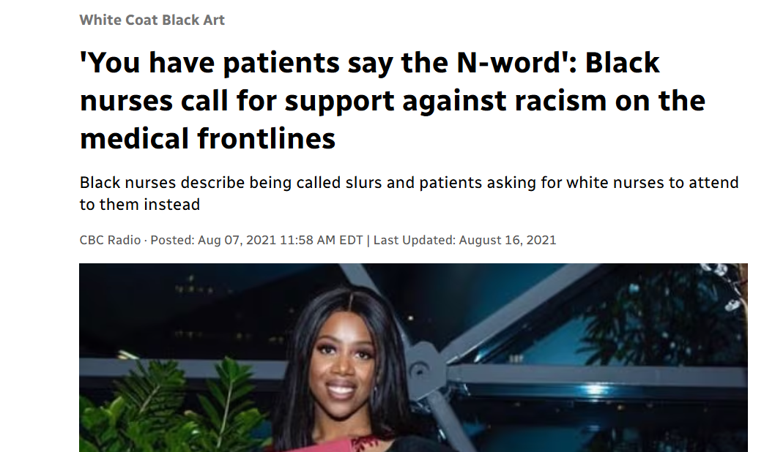
Notes:
Sources:
One Big Beautiful Bill Act: Understanding the healthcare impacts
8.7M few (Director Forum Slide deck)

Slide 11
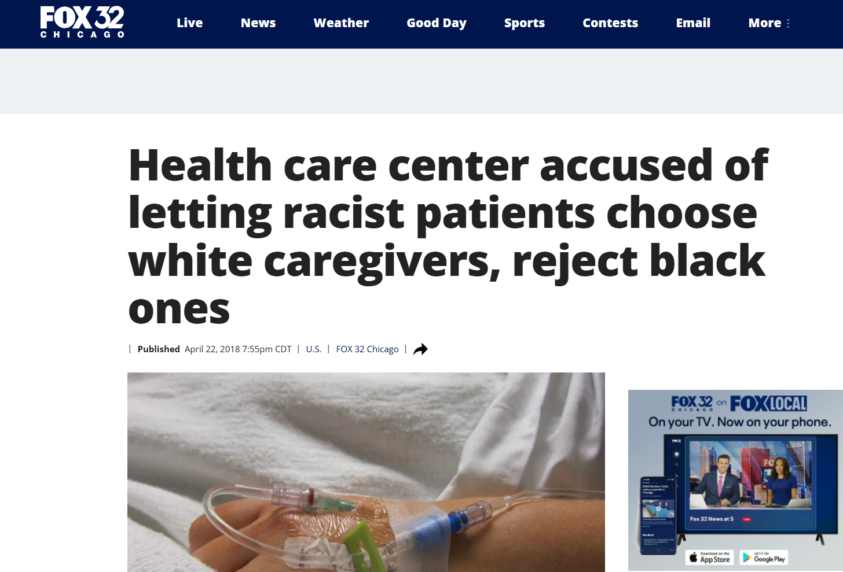


Slide 12
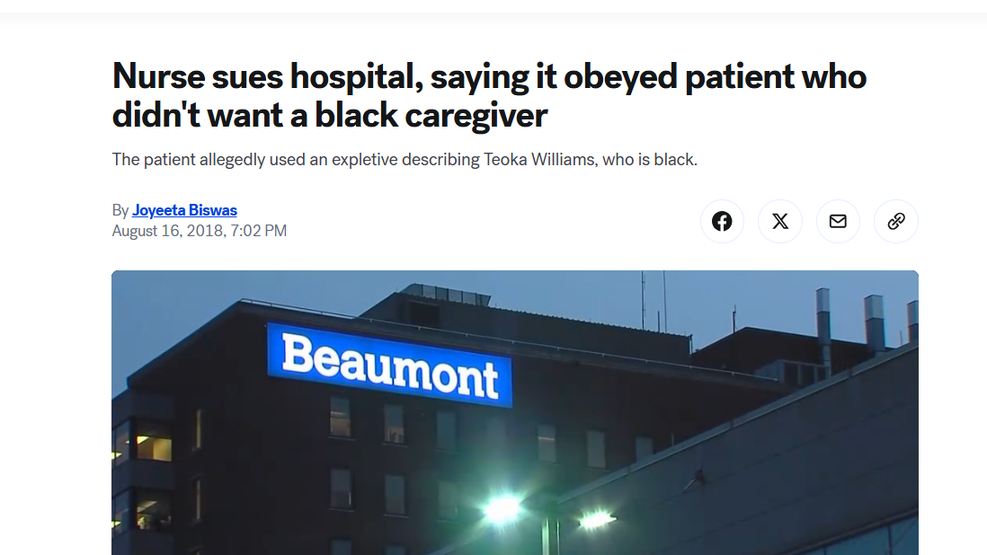

Slide 13
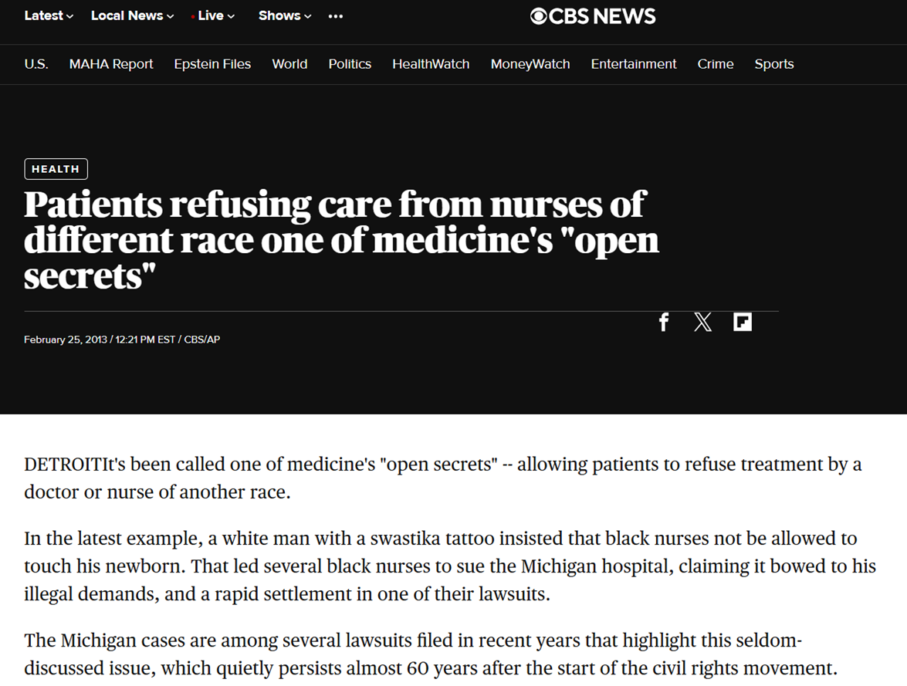
“It’s been called one of medicine’s open secrets…”
Notes:
Sources:
One Big Beautiful Bill Act: Understanding the healthcare impacts
Fiscal Brief: The One Big Beautiful Bill Act of 2025

Slide 14
Signed into law on July 4, 2025
Over $1 trillion in cuts to Medicaid, Medicare, and ACA programs
Key Provisions:
  Medicaid work requirements
  Marketplace tax credit restrictions and cost-sharing increases
  State Medicaid financing restrictions
  Medicare sequestration triggers
A Historic Shift: The OBBBA and its Far-Reaching Effects
Notes:
Sources:
One Big Beautiful Bill Act: Understanding the healthcare impacts
Fiscal Brief: The One Big Beautiful Bill Act of 2025

Slide 15
A Historic Shift: The OBBBA and Its Far-Reaching Effects
Signed into law on July 4, 2025
Over $1 trillion in cuts to Medicaid, Medicare, and ACA programs
Key Provisions:
  Medicaid work requirements
  Marketplace tax credit restrictions and cost-sharing increases
  State Medicaid financing restrictions
  Medicare sequestration triggers
Notes:
Sources:
One Big Beautiful Bill Act: Understanding the healthcare impacts
Fiscal Brief: The One Big Beautiful Bill Act of 2025

Slide 16
Medicaid “Work Requirements”
80 hours/month working, job training or performing community service
Exceptions: Individuals who are…
      Pregnant
      Caring for dependents
      Students
      Medically unable to comply

Slide 17

Ahhhh…the fine print
Work REPORTING Requirement Arkansas …. DISASTER!!
Reporting twice a year
18,000 loss their coverage
Costs the state $24M

Slide 18
Signed into law on July 4, 2025
Over $1 trillion in cuts to Medicaid, Medicare, and ACA programs
Key Provisions:
  Medicaid work requirements
  Marketplace tax credit restrictions and cost-sharing increases
  State Medicaid financing restrictions
  Medicare sequestration triggers
A Historic Shift: The OBBBA and Its Far-Reaching Effects
Notes:
Sources:
One Big Beautiful Bill Act: Understanding the healthcare impacts
Fiscal Brief: The One Big Beautiful Bill Act of 2025

Slide 19

Affordable Care Act (Obamacare)… The plan to kill it…and how it affects ALL of us.
Challenged in the Courts 60 Times

Slide 20

Quick Primer on ACA
Eligibility based on income & family size
You could qualify for Obamacare if:
Single and make $58,320
Family of 4 earning $120,000/year.

Slide 21
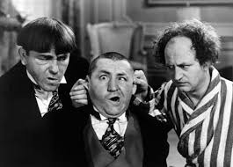
What’s the Plan?
The Plan:
The Federal Government will stop subsidizing insurance premiums for those with Obamacare
The Result:
*Insurers participating in ACCA Marketplaces filed median rate changes for 2026, and the median proposed increase is 18%
*Kaiser Family Foundation

Slide 22
What’s the Plan?
Michigan
*Rate filings for 2026=16.8%
BUT, BUT, BUT…
**If Enhanced premium tax credits expire Out-of-pocket cost will rise dramatically—KFF estimates up to 75% higher for most people
*State of Michigan Department of Insurance and Financial Services
**Health System Tracker

Slide 23
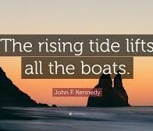
But what’s that got to do with me?
Risk pooling

Slide 24
Medicaid reduced enrollment and cuts
ACA reduced enrollment and cuts
Medicare cuts
Tariff and inflation increases
Grant funding cuts
Biggest Impact on Michigan Health Systems
Notes:
Source: AB slides Bill sent

Slide 25
Who Gets Left Behind? Real Lives, Real Losses
Coverage Loss
7.8M – 14.9M fewer on Medicaid, hitting minorities hardest
Health Equity
Threatens progress in maternal and chronic care
Barriers
Work rules & paperwork drop coverage for vulnerable groups
Community Impact
Safety net hospitals & FQHCs face new challenges
Notes:
8.7M few (Director Forum Slide deck)
NHCHC Fact Sheet (health equity impact on maternal & chronic care)
https://nhchc.org/wp-content/uploads/2025/07/Big-Beautiful-Bill-Act-fact-sheet.pdf
Worsening health conditions: Without coverage, patients will be much less able to access the health care services they need to manage chronic illnesses, improve health outcomes, and achieve stability. The high cost of care when uninsured will increase medical debt and deter people from seeking treatment, causing people to get sicker and increasingly dependent on hospitals and emergency departments for routine care.
*With cuts, hospitals may have to rollback maternal health programs.
CA Immigrant Policy Center (Safety net)
https://caimmigrant.org/wp-content/uploads/2025/07/Breaking-Down-HR-1.pdf
Fact Sheet
Food assistance/SNAP provisions: Over 22 million families likely to lose food assistance because the OBBBA expands work requirements, removes eligibility for refugees/asylees without permanent residency, caps future benefit increases, and adds penalties to states for error rates

Slide 26

Our Call to Action
Demand Accountability
  Ask local leaders, State Legislators, and Congress
Know your rights, understand the issues, and ACT with intention
VOTE

Slide 27
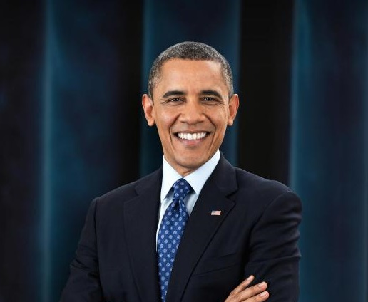
"For all our differences, we are one people—stronger together than we could ever be alone."
~Barack Obama

Slide 28
Thank You

